Slide 1
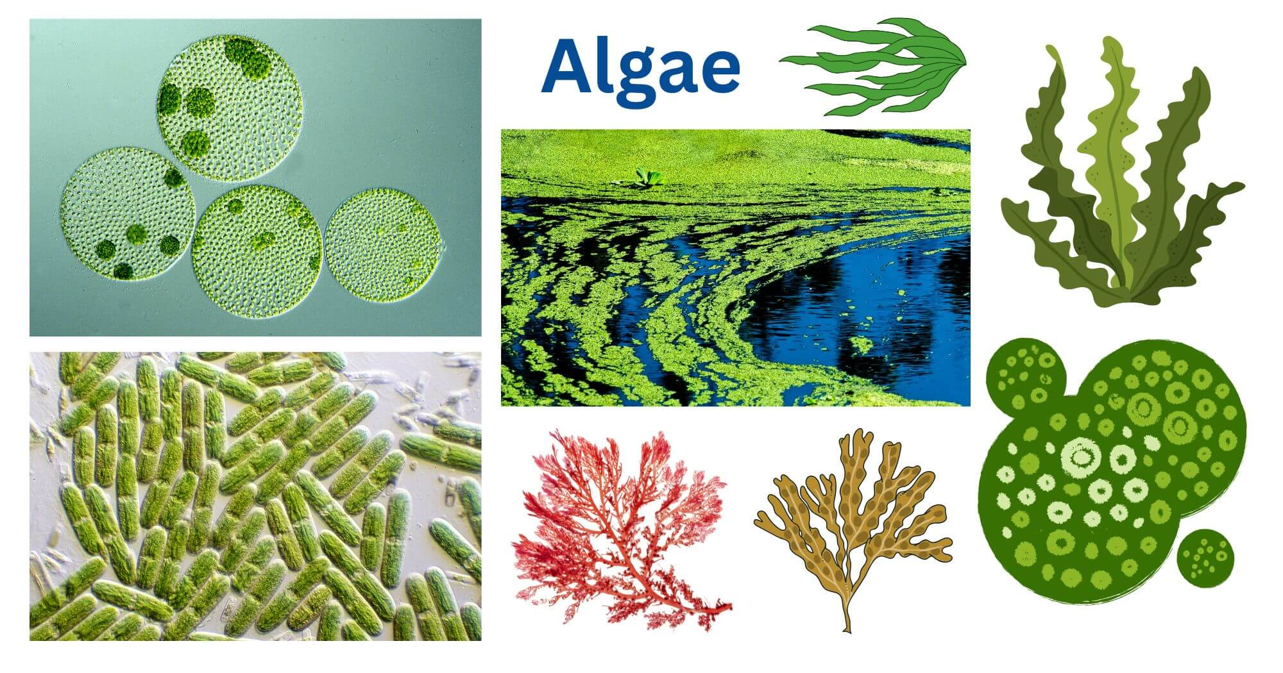
Algal Diversity In Habitat
Dr. Trilok Kumar
Assistant Professor
Govt. Digvijay Autonomous PG College, Rajnandgaon, C.G.

Slide 2
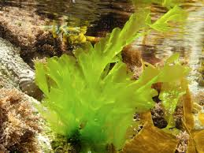
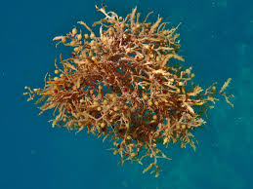
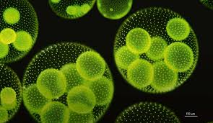
Algae
Study of Algae - Phycology
Definition
Eukaryotic, Thallophytic, Photosynthetic, Avascular, Cryptogamus plants are called Algae.
Term Algae- Latin word. First used by Linnaeus (1754) for
Seaweed.

Slide 3
Alga in Diversified Habitat
Mostly: Aquatic, found fresh water (Pond, Ditches, Rivers, Springs), marine water, moist rocks, other moist terrestrial habitats.
Types of Habitat: On the basis of their +nce in different places:
Three types
Aquatic Habitat
Terrestrial Habitat
3. Special Habitat

Slide 4
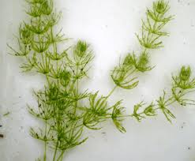
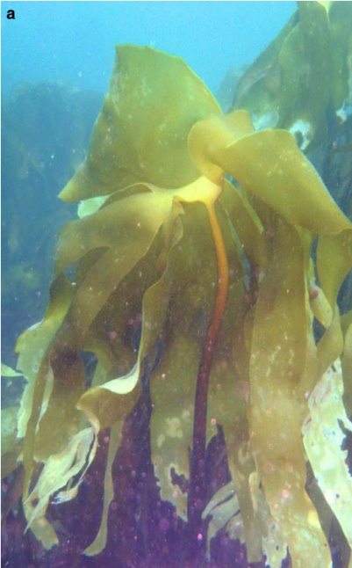
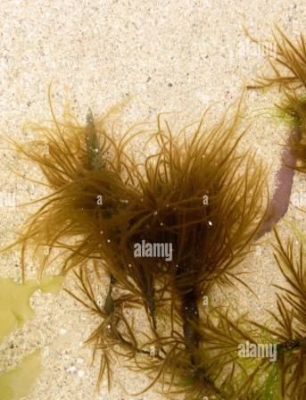
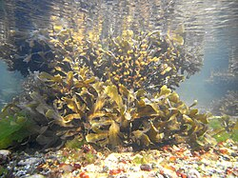
Aquatic Habitat: On the basis of nature of water, Two types:
(i) Fresh water algae: Found in fresh water like Pond, river, ditches, lake, springs etc.
Members of Chlorophyceae, Charophyceae, Cyanophyceae & Xanthophyceae.
e.g. Volvox, Chara etc.
(ii) Marine algae: Found in sea water/ salty water.
Member of Phaeophyceae an Rhodophyceae.
e.g. Ectocarpus, Sargassum, Fucus, Laminaria etc.

Slide 5
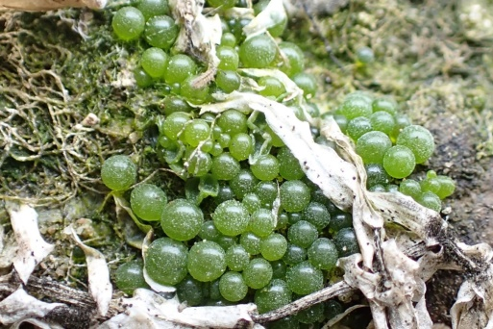
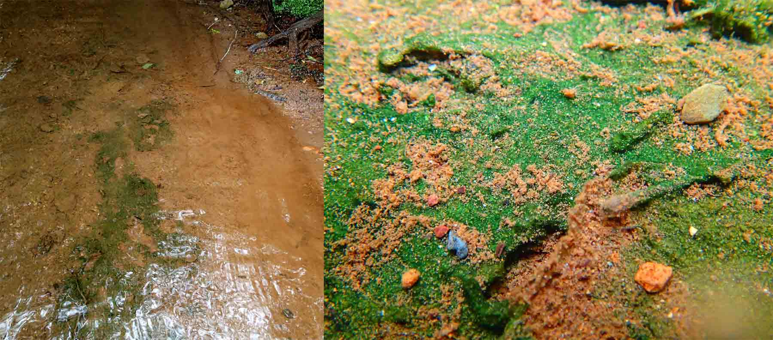
2. Terrestrial Habitat:
Some algae are found on moist and water logged soil.
These algae are called: Edaphophytes.
e.g. +nt in moist soil: Vaucheria, Botrydium etc.
+nt in moist acidic soil: Frischiella
+nt in moist alkaline soil: Oscillatoria, Nostoc etc.
Botrydium
Oscillatoria

Slide 6
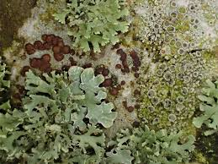
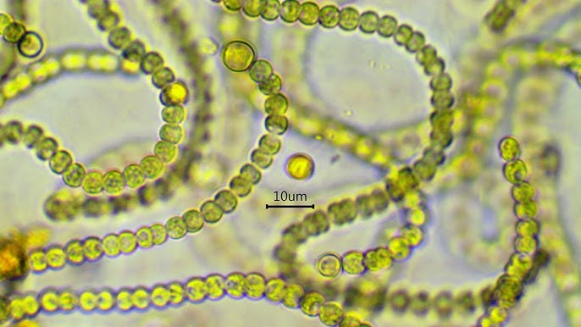
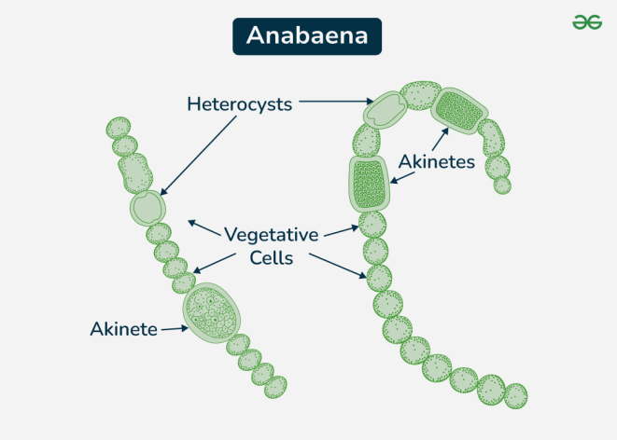
3. Special Habitat:
Some algae are found on special habitat.
(i) Epiphytic algae: Found on other plant species.
e.g. Ulotrix, Oedogonium etc.
(ii) Symbiotic algae: Some algae Shows symbiotic relationship with others
e.g. Lichen: Association of Algae & Fungi.
Nostoc & Anabaena with Cycas coralloid roots.
Azola (Aquatic fern) leaf associated with BGA Anabaena azollae.
Thallus of Anthoceros (Bryophyte) associated with BGA Nostoc.
Nostoc

Slide 7
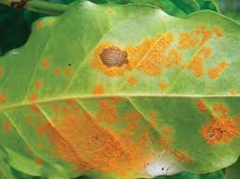
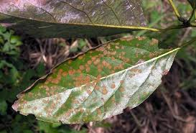
(iii) Parasitic algae: Some algae Parasite on other plants.
e.g. Cephaleuros algae parasite on Tea & Coffee plants causes rust disease.
Red rust caused by Cephaleuros parasiticus
Cephaleuros virescens (algal spot of coffee)

Slide 8
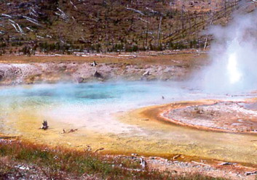
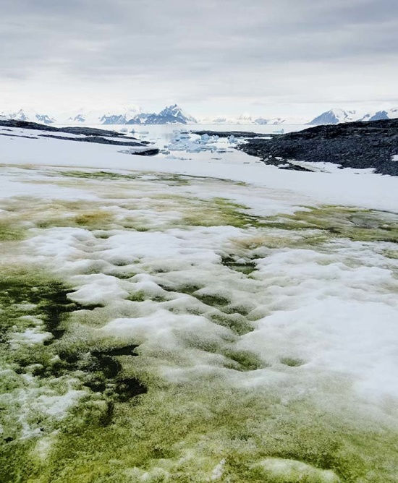
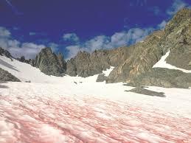
(iv) Thermal algae: Found on hot water spring (Temp. 70-85⁰C).
e.g. BGA like Phormidium, Mastigocladus etc.
Fig: Mastigocladus in Hot water spring
(v) Cryptophytic Cryophytic algae: Some algae in ice & snow of polar region.
e.g. Chlamydomonas nivalis, Scottiella sp. etc.
Chlamydomonas nivalis

Slide 9
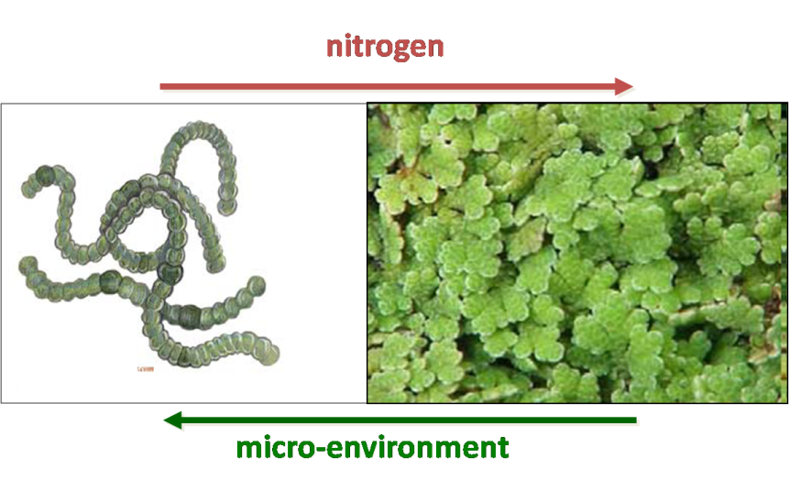
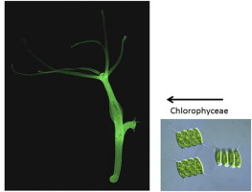
(vi) Endophytic Algae: Some algae grow inside the plant body.
e.g. Azola (Aquatic fern) leaf associated with BGA Anabaena azollae.
Thallus of Anthoceros (Bryophyte) associated with BGA Nostoc.
(vii) Endozoic algae: Some algae grow inside the body of animal.
e.g. Chlorella +nt inside Hydra and Sponges.
Chlorella +nt inside Hydra

